Slide 1
Deep Reinforcement Learning with Double Q-learning
Flappy Bird Hacking using Deep Reinforcement Learning
Shubham | Naman | Ziyu | Jianqiu | Zhenye

Slide 2
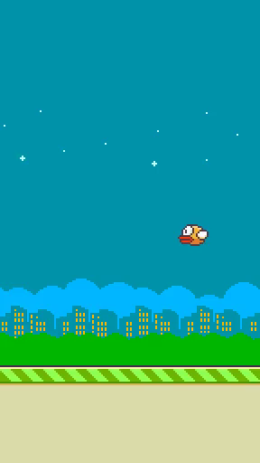

Introduction
Paper: Deep Reinforcement Learning with Double Q-learning
About this project
We implement DDQN on PLE FlappyBird environment in PyTorch
Why DDQN?
DDQN is proposed to solve the overestimation issue of Deep Q Learning (DQN).
Apply separate target network to choose action,
reducing the correlation of action selection and value evaluation.
The best agent
https://github.com/drl-dql/DQN-Flappy-Bird
Notes:
Introduction (20s)
Several sentences about the paper that we’re implementing, what games our code is running for, and a brief outline of our presentation?
Include a couple of videos
(Put a video on this page so that it looks fancy! :P)
Implementation (25s)
Assumption
Environment - flappy bird (actions, objective, how to play)
Explaining the CNN and the agent (Q network and target network)
Experiment Setup (15s)
Hyperparameters (including the parameters of the paper)
Results of Experiments (5 min)
(Or split this by different games)
Videos : put videos together with plots while explaining the plots
Plots : plots should tell a story as in why reward/loss is behaving in a particular way with a particular set of hyperparameters OR comparison of two different experiments’ results giving intuition about how change of hyperparameters affected reward/loss
Also, it’s a great idea to group experiments based on hyperparameters
Conclusion (0s, just display) : summary of results, and intuition on effects of different hyperparameters (What will happen if we change one hyperparameter and why. We should be able to explain these in section 4 and we only summarize them here). Include a couple of videos again

Slide 3
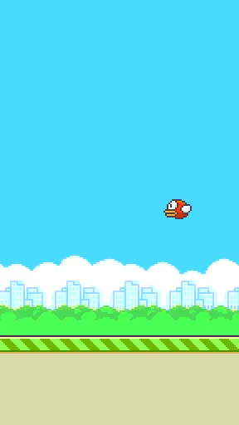
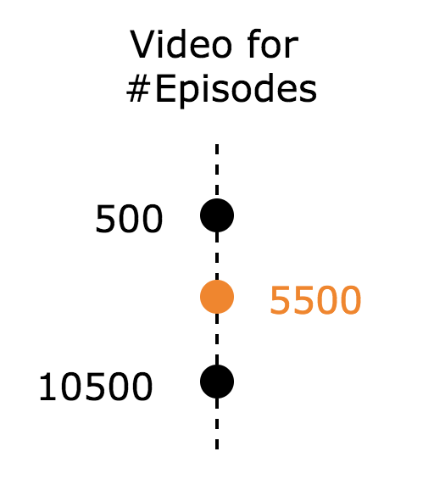
Implementation: Environment
Valid Actions
Up causes the bird to accelerate upwards.
Terminal states (game_over)
If the bird makes contact with the ground, pipes or goes above the top of the screen the game is over.
Rewards
For each pipe it passes through it gains a positive reward of +1. For each frame the live bird receives reward of +0.1. Each time a terminal state is reached it receives a negative reward of -1.

Slide 4
Experimental Setup: Hyperparameters
Optimizer
Learning Rate
Discount Factor
Replay Buffer Size
Optimizer
LR
Discount Factor
reply buffer size
total episodes
update target frequency
initial epsilon
minimum epsilon
epsilon discount rate
batch size
initial observe episode
maximum model
screen width
screen height
Total Episodes
Target Frequency
Epsilon
Batch Size
Initial Observed Episodes
Epsilon Discount
Screen Width
Screen Height

Slide 5
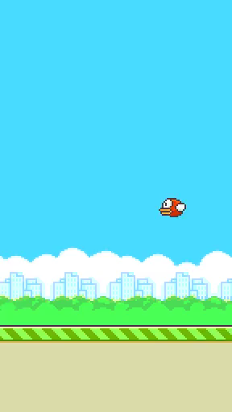
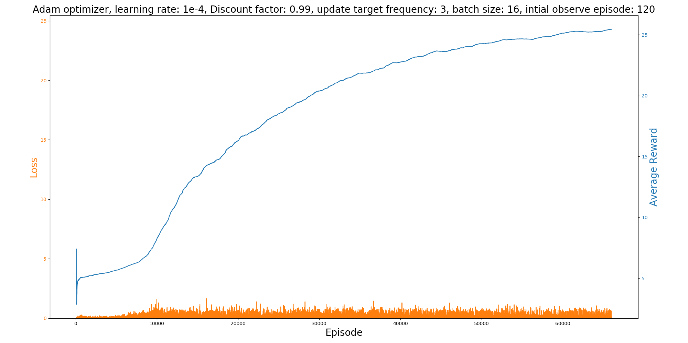
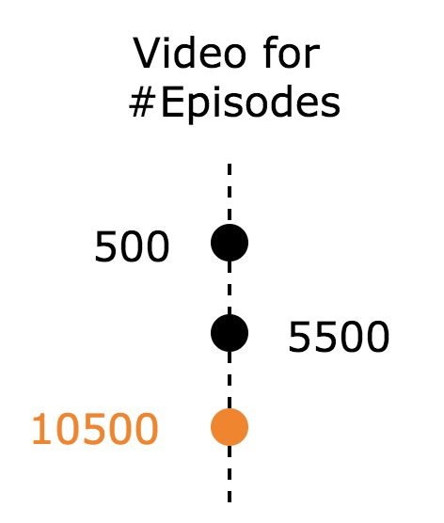
Experimental Results: Best

Slide 6
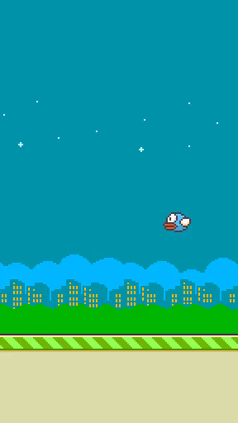
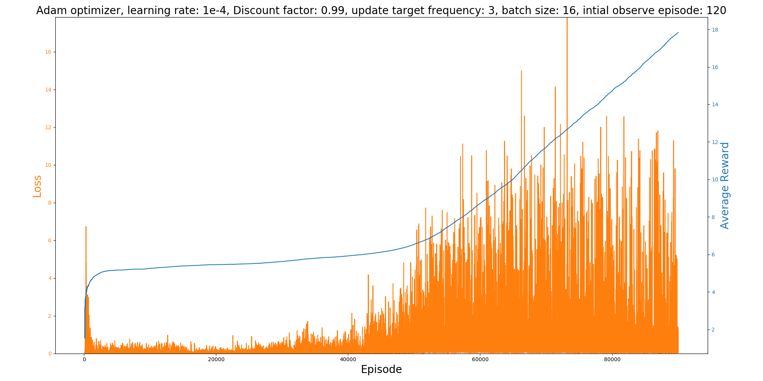
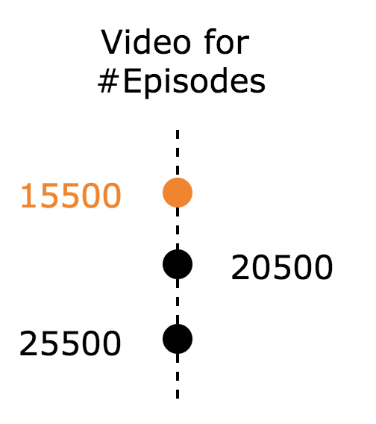
Experimental Results: Worst

Slide 7
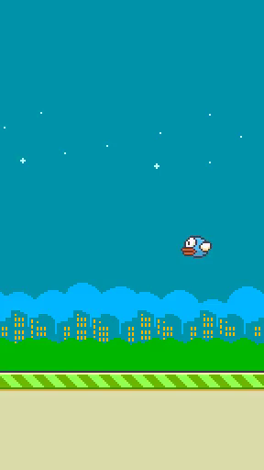
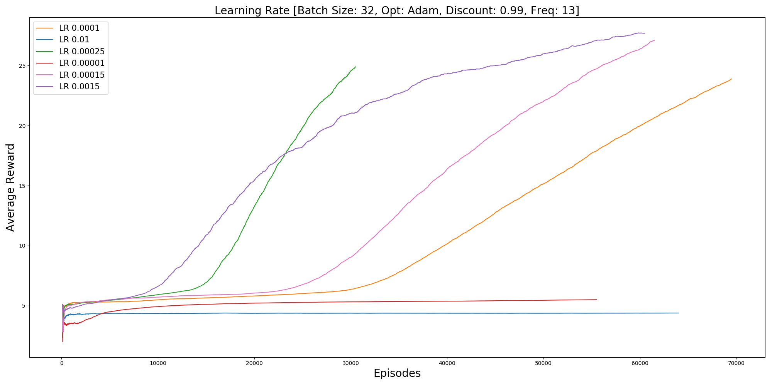
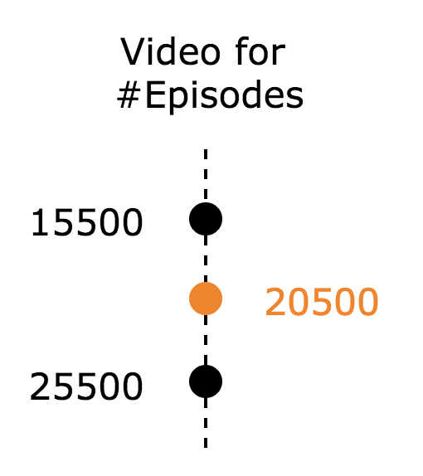
Learning Rate Analysis

Slide 8
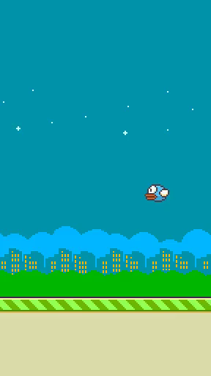
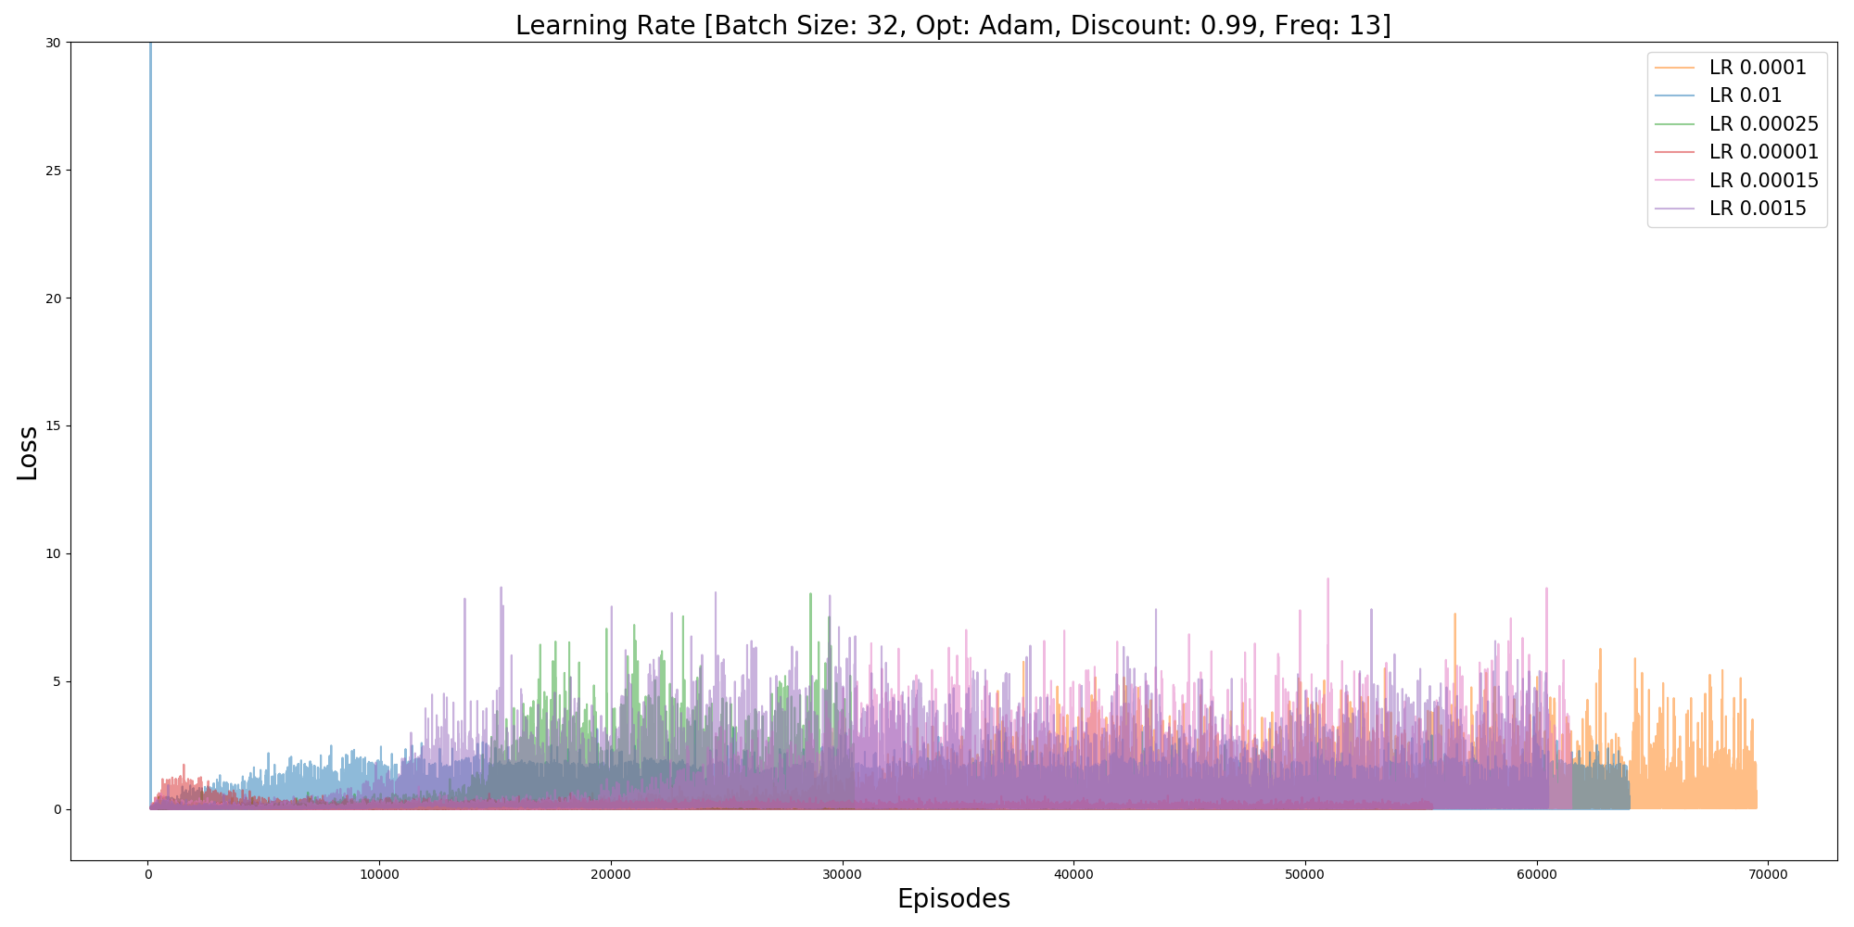
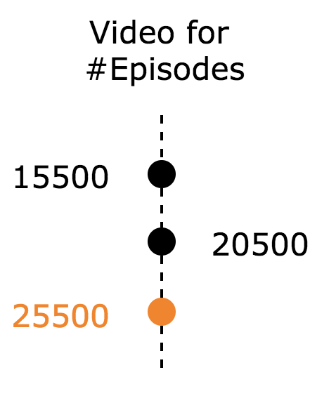
Learning Rate Analysis

Slide 9
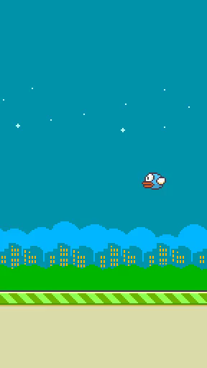
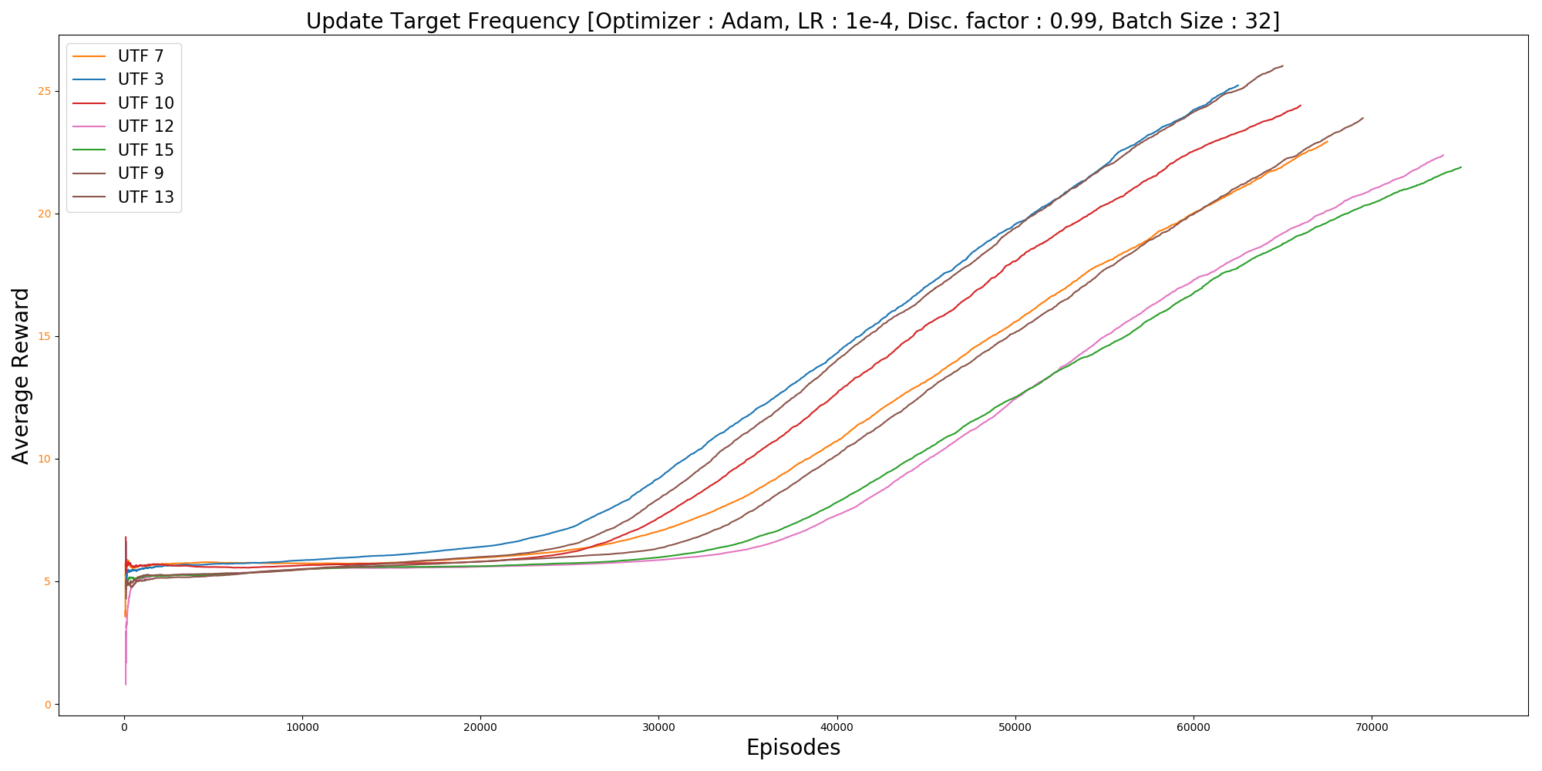
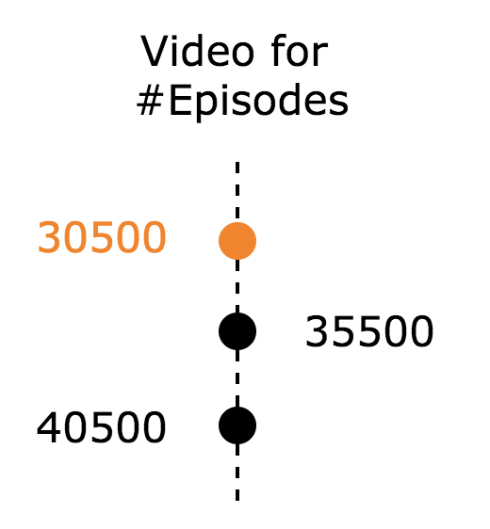
Update Target Frequency Analysis

Slide 10
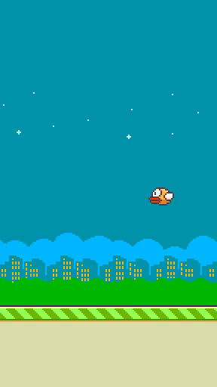
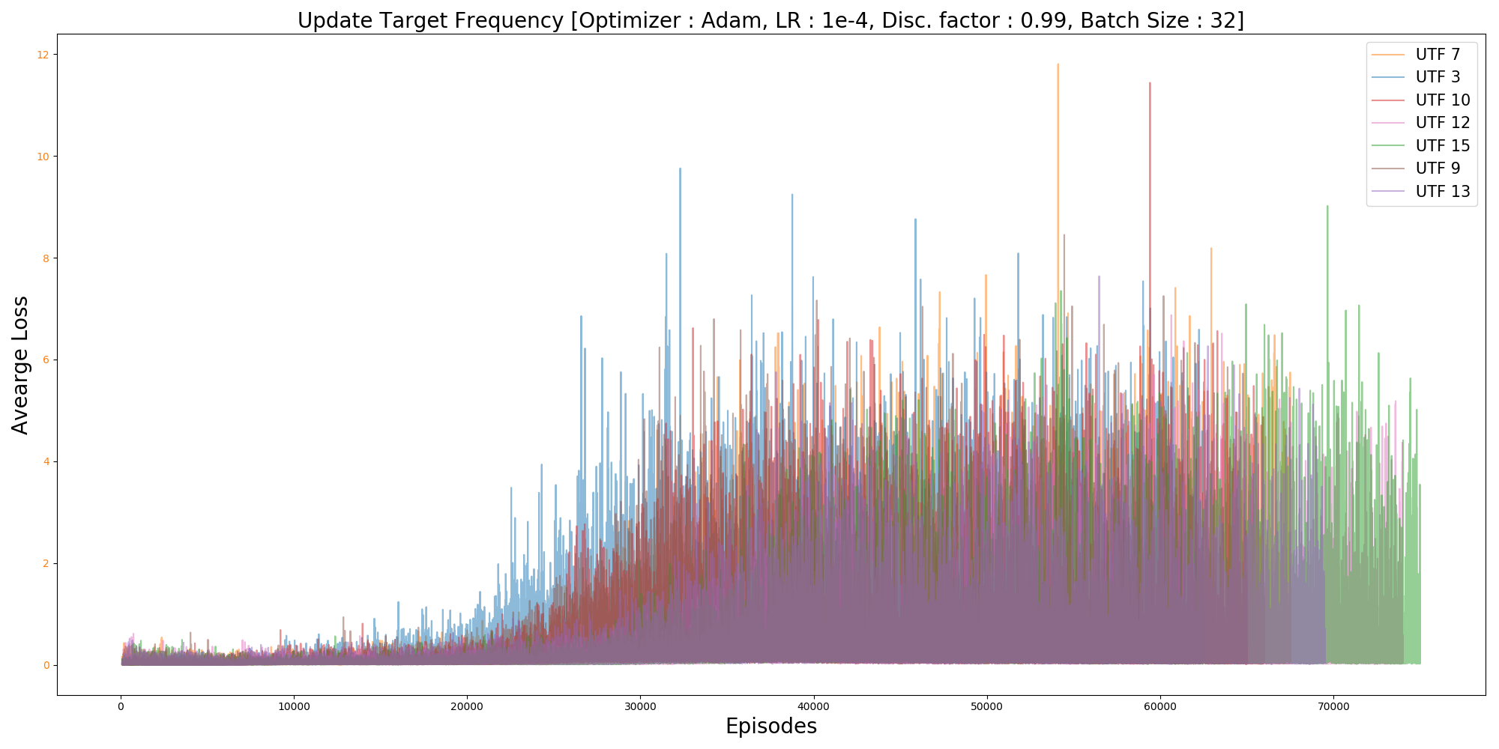
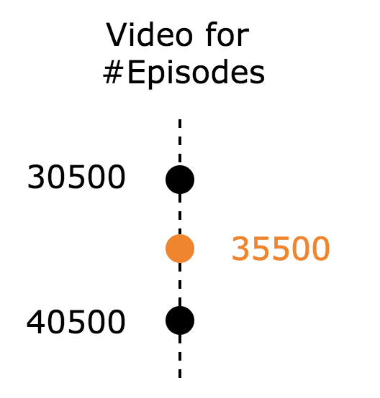
Update Target Frequency Analysis

Slide 11
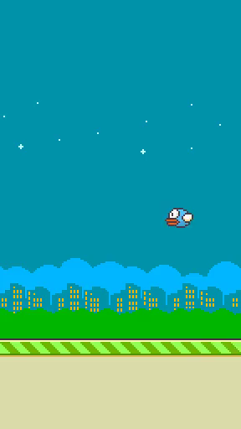
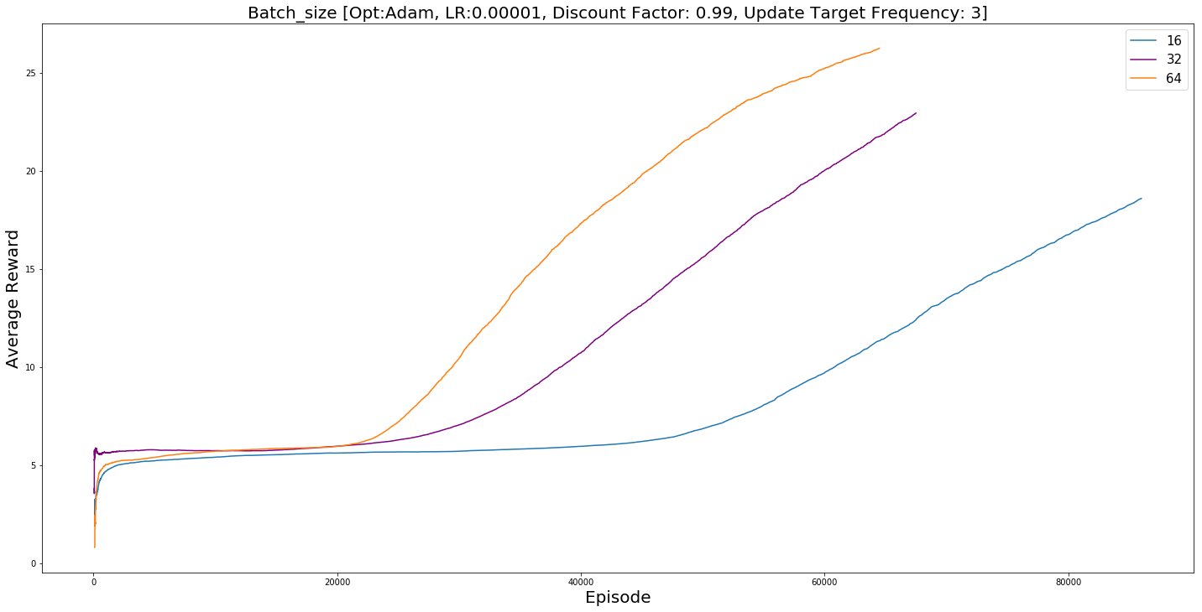
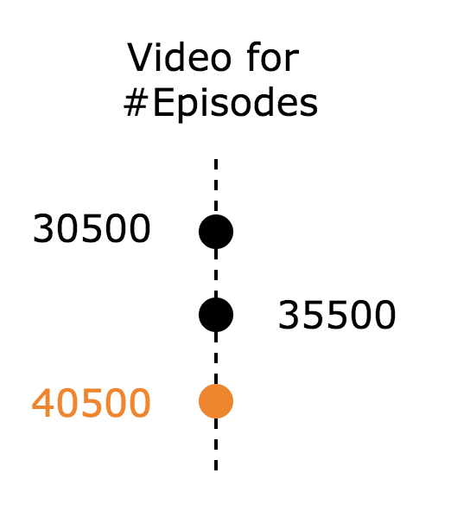
Batch Size Analysis

Slide 12

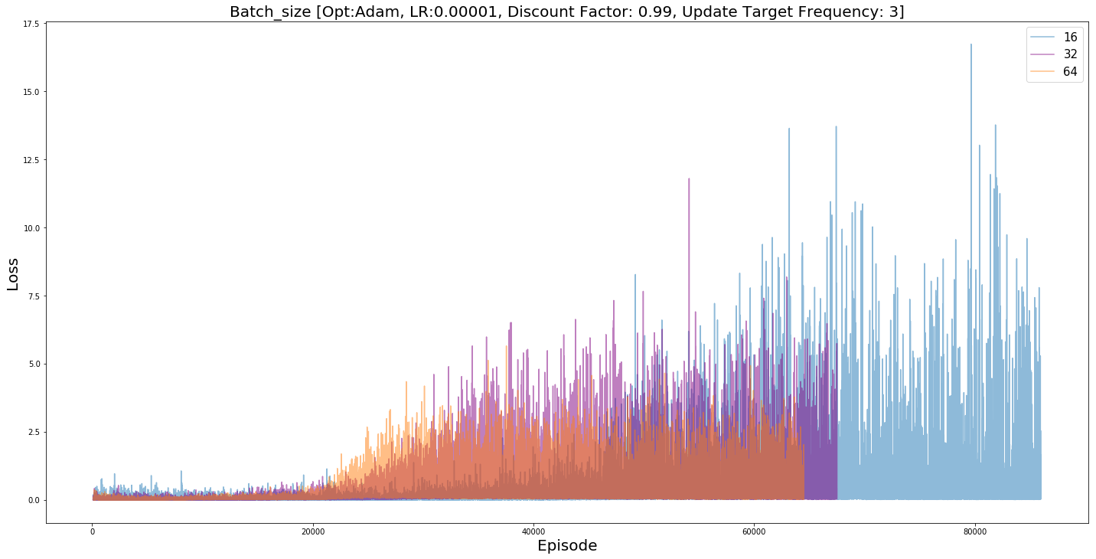
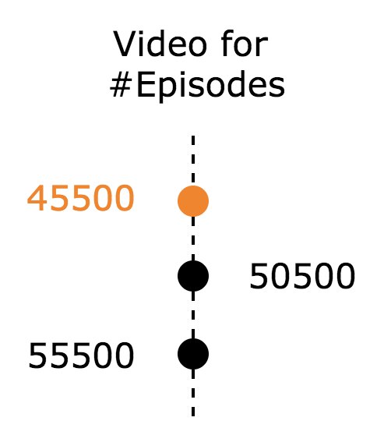
Batch Size Analysis

Slide 13
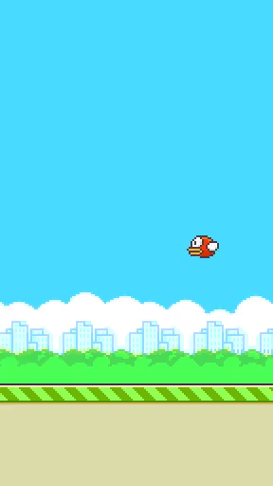
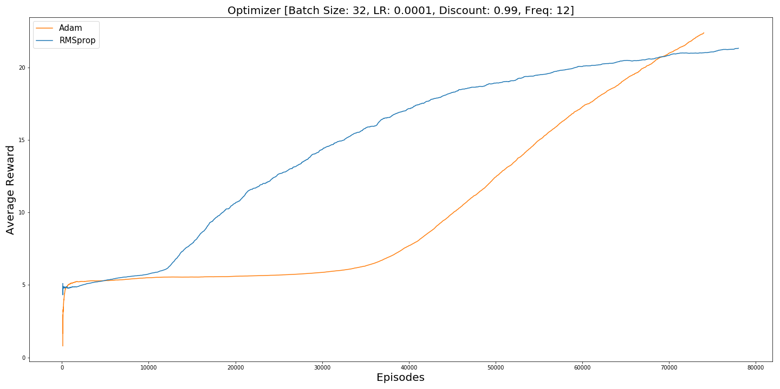
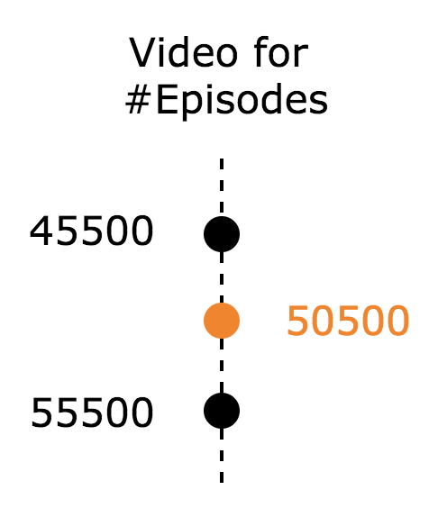
Optimizer Analysis

Slide 14
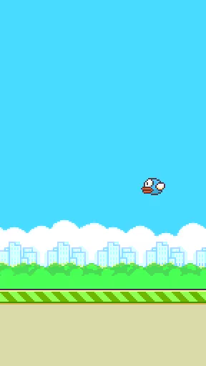
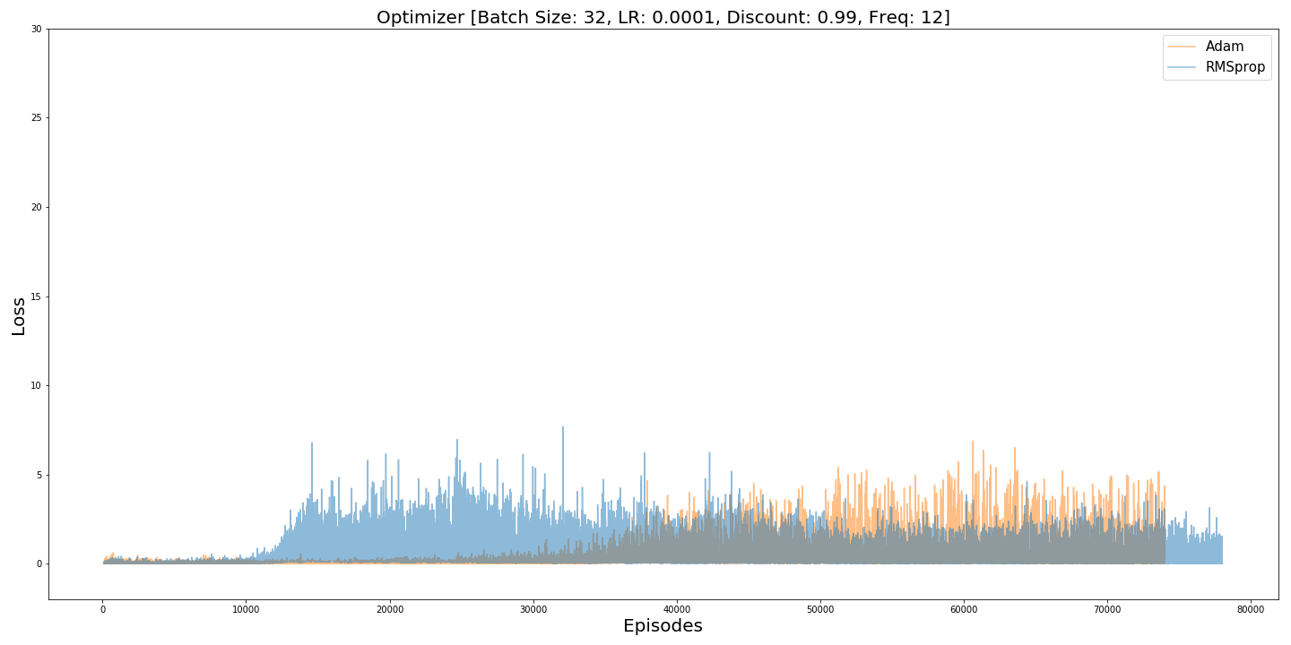
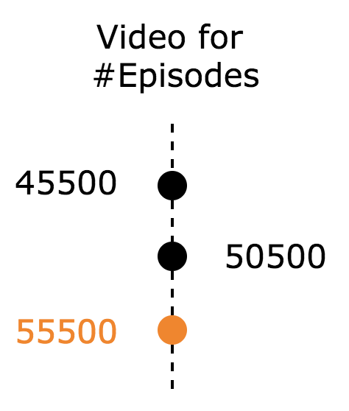
Optimizer Analysis

Slide 15
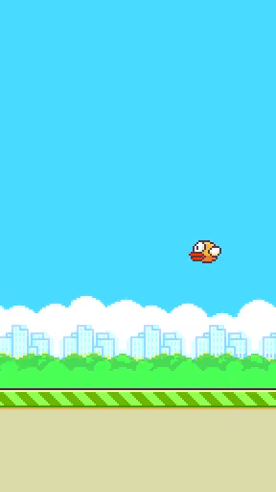
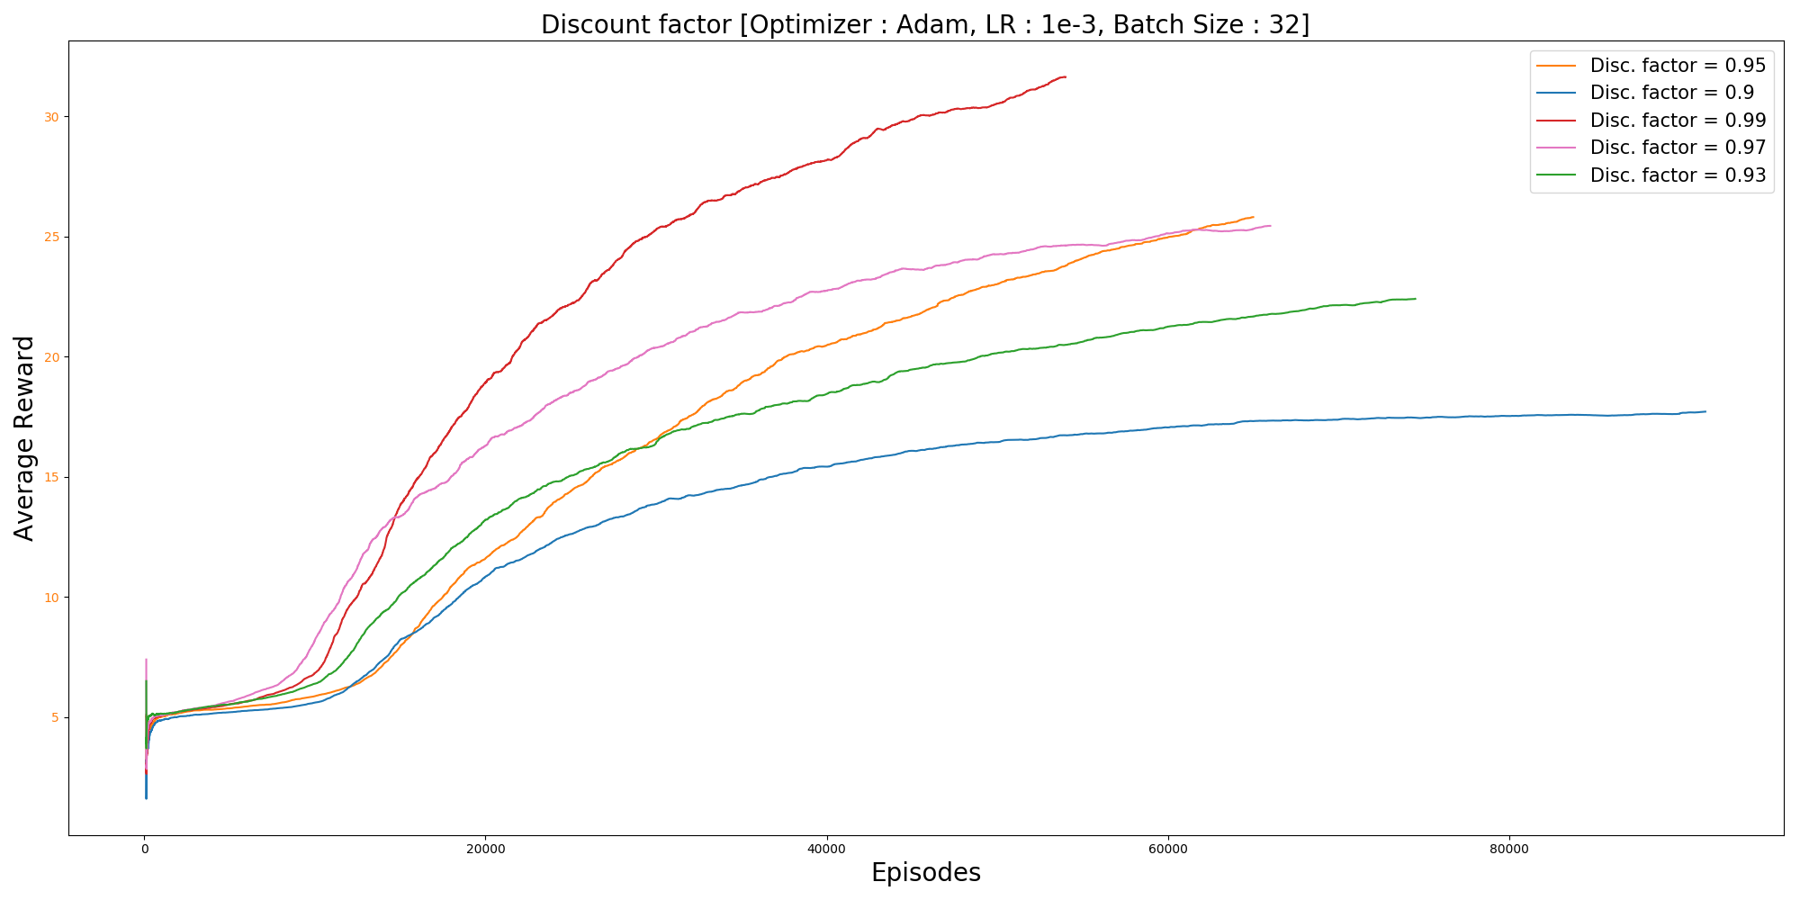
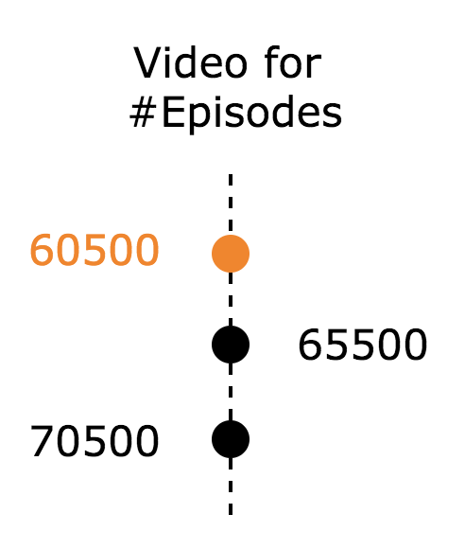
Discount factor Analysis

Slide 16
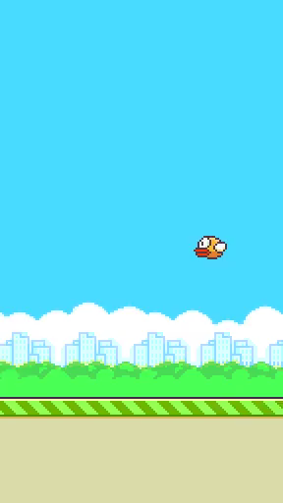
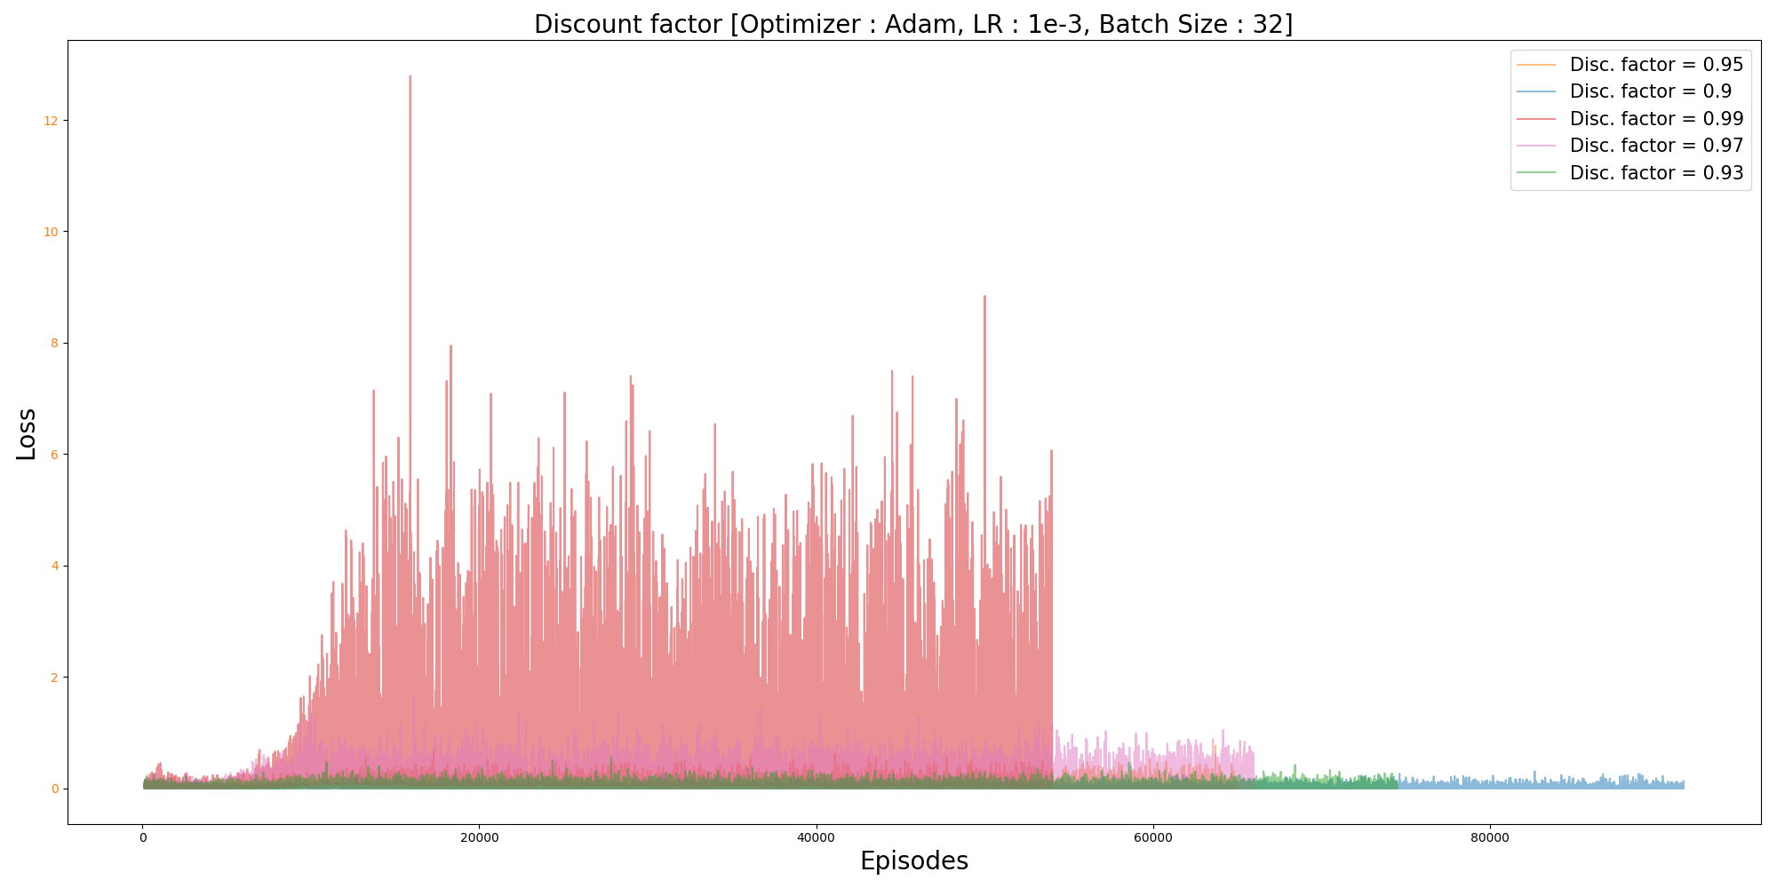
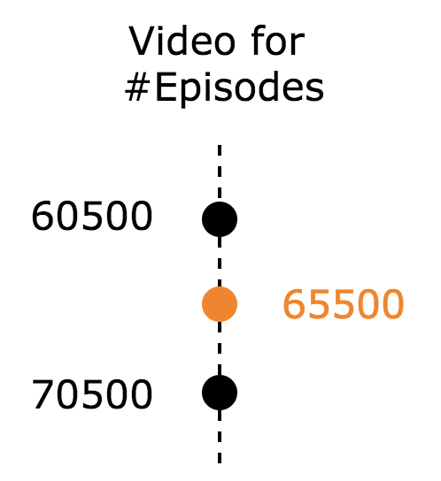
Discount factor Analysis

Slide 17
Questions?
Resources Used
Blue Waters ~ 1300 Computation Hours
Google Colab (Free GPU) ~ 30 Hours
https://github.com/drl-dql/DQN-Flappy-Bird

